Slide 1
IBM University Engagement Project Submission
“Exploring the Power of Agentic AI with IBM Granite and IBM Bob”

Slide 2

Project Tile – [College Admission Agent]
Domain of Project – [ Education ]
Student Name | Recent Passport Photo | Email ID | Mobile number [WhatsApp]
Praveen Kumar Singh |  | naveenkumarsingh7376@gmail.com | 8840469757

Slide 3
Problem Statement -
The Challenge
The college admission process involves a large amount of information such as:
* Course details
* Eligibility criteria
* Admission policies
* Fee structures
* Required documents
* Application procedures
* Important admission dates
* Frequently asked questions
Students often have difficulty finding the correct information quickly.
Proposed Approach
A RAG-based College Admission Agent retrieves relevant information from trusted college documents and official sources and uses IBM Granite to generate accurate, context-aware responses.

Slide 4
Proposed Solution -
Proposed Solution
College Admission Agent
Our solution is a custom web-based AI chatbot that acts as a virtual admission assistant.
How It Works
1. Student Query
Student asks a question in natural language.
↓
2. Query Processing
The system understands the student's requirement.
↓
3. RAG Retrieval
Relevant information is retrieved from the college knowledge base.
↓
4. IBM Granite
IBM Granite generates a response using the retrieved information.
↓
5. Chatbot Response
The student receives a clear and useful answer through the website.

Slide 5
Technology Used
IBM Granite
Used as the foundation model for generating natural-language responses.
Processes retrieved admission information.
Generates conversational answers.
IBM Cloud Lite
Cloud environment for developing and deploying the AI solution.
Supports IBM services required for the project.
IBM Bob
Helps in building and developing the AI-powered application.
Supports agentic workflow development.
RAG — Retrieval-Augmented Generation
Retrieves relevant information before generating an answer.
Helps keep responses grounded in trusted admission information.
Custom Website
Provides the user interface for students and applicants.
Integrates the admission chatbot into the college website.

Slide 6
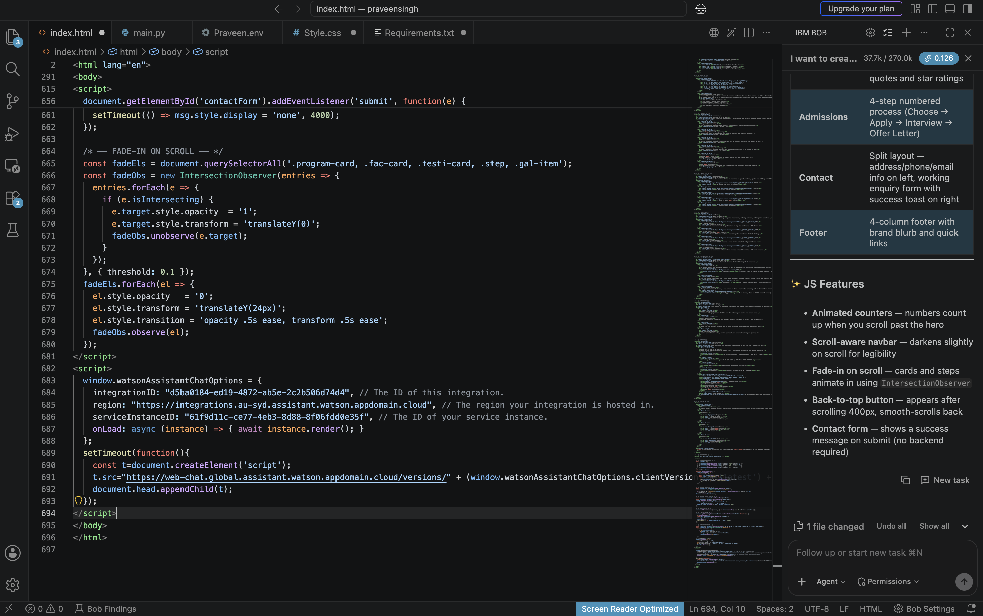
Required Files created using IBM bob -
main.py
Requirements.txt
Style.css
Praveen.env
index.html

Slide 7
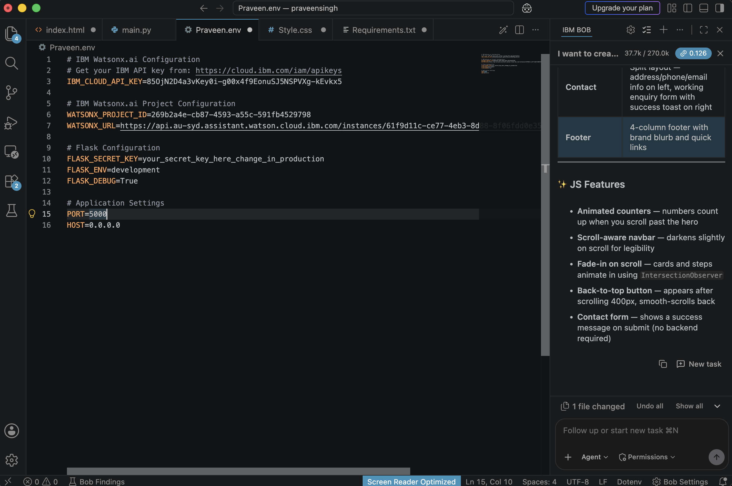
IBM Bob Screenshots:

Slide 8
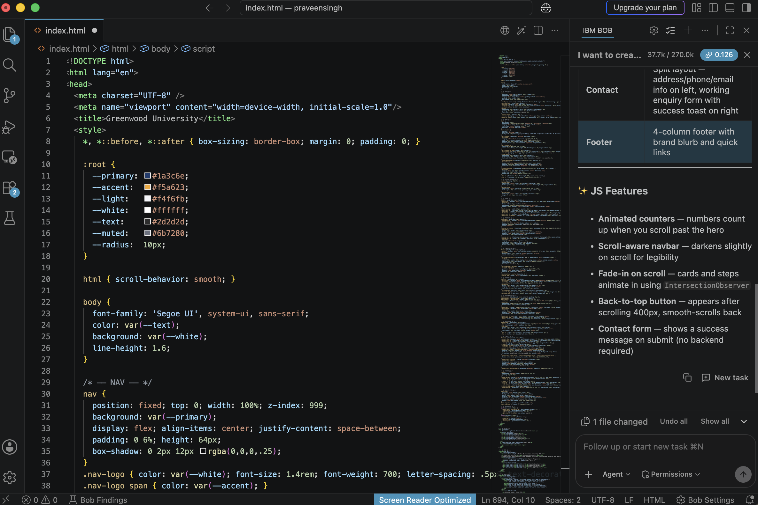

Slide 9
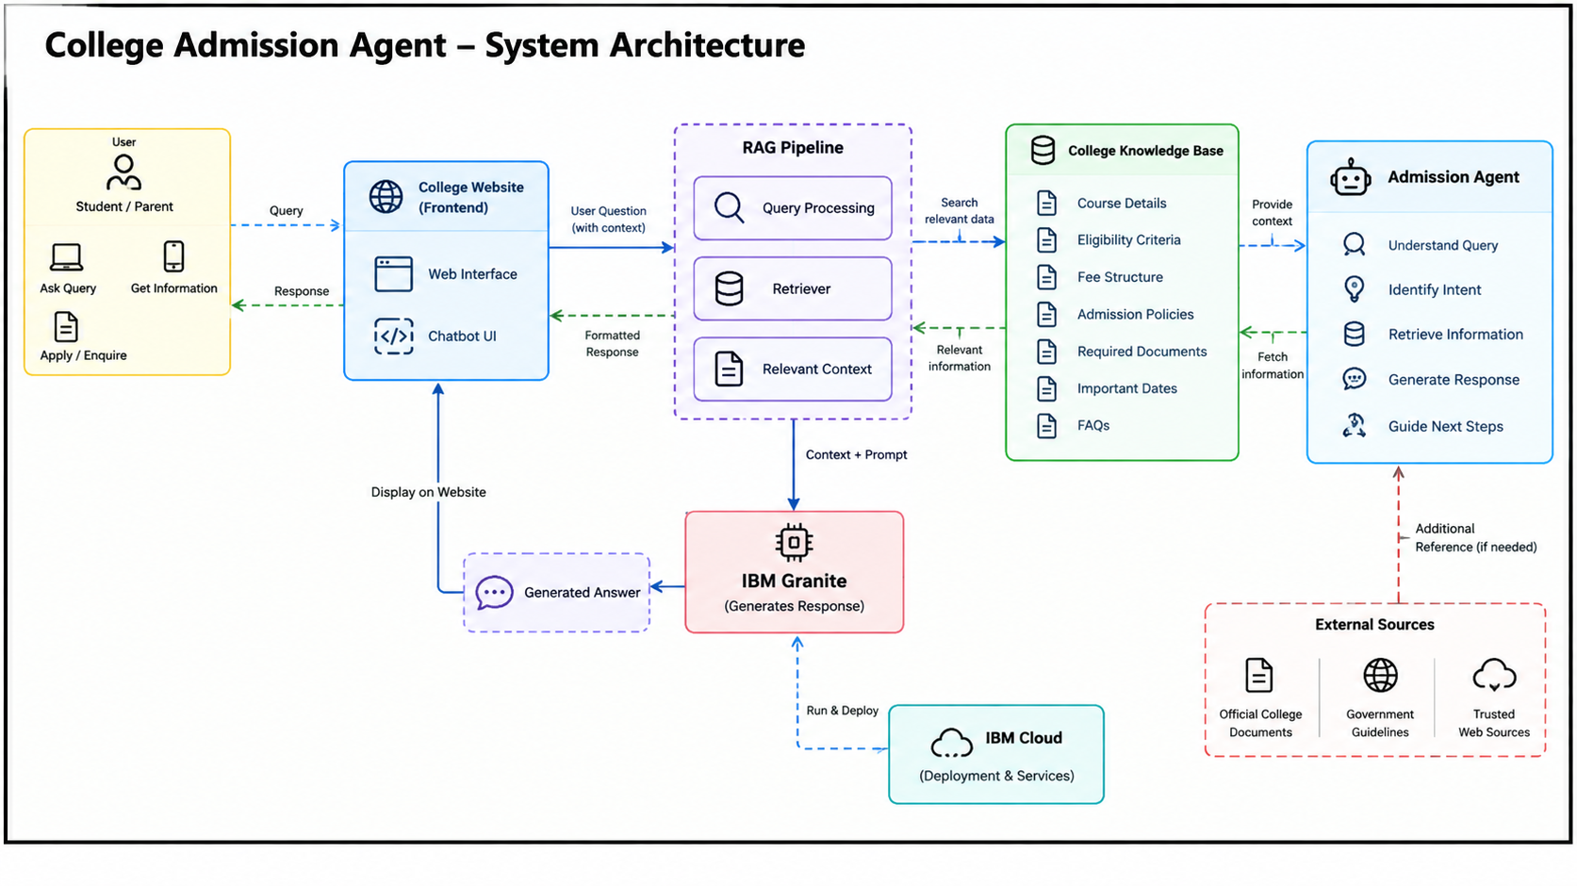

Slide 10

Role of Agentic AI in the solution
Role of Agentic AI
The College Admission Agent uses agentic AI concepts to make the chatbot more intelligent and task-oriented.
Capabilities
* Understand student questions.
* Identify the type of admission query.
* Retrieve relevant information.
* Use retrieved context to generate responses.
* Maintain conversational context.
* Provide appropriate next-step guidance.
* Handle different admission-related tasks.
Possible Tasks
Course Selection → Eligibility → Fees → Application → Documents → Deadlines → FAQs

Slide 11
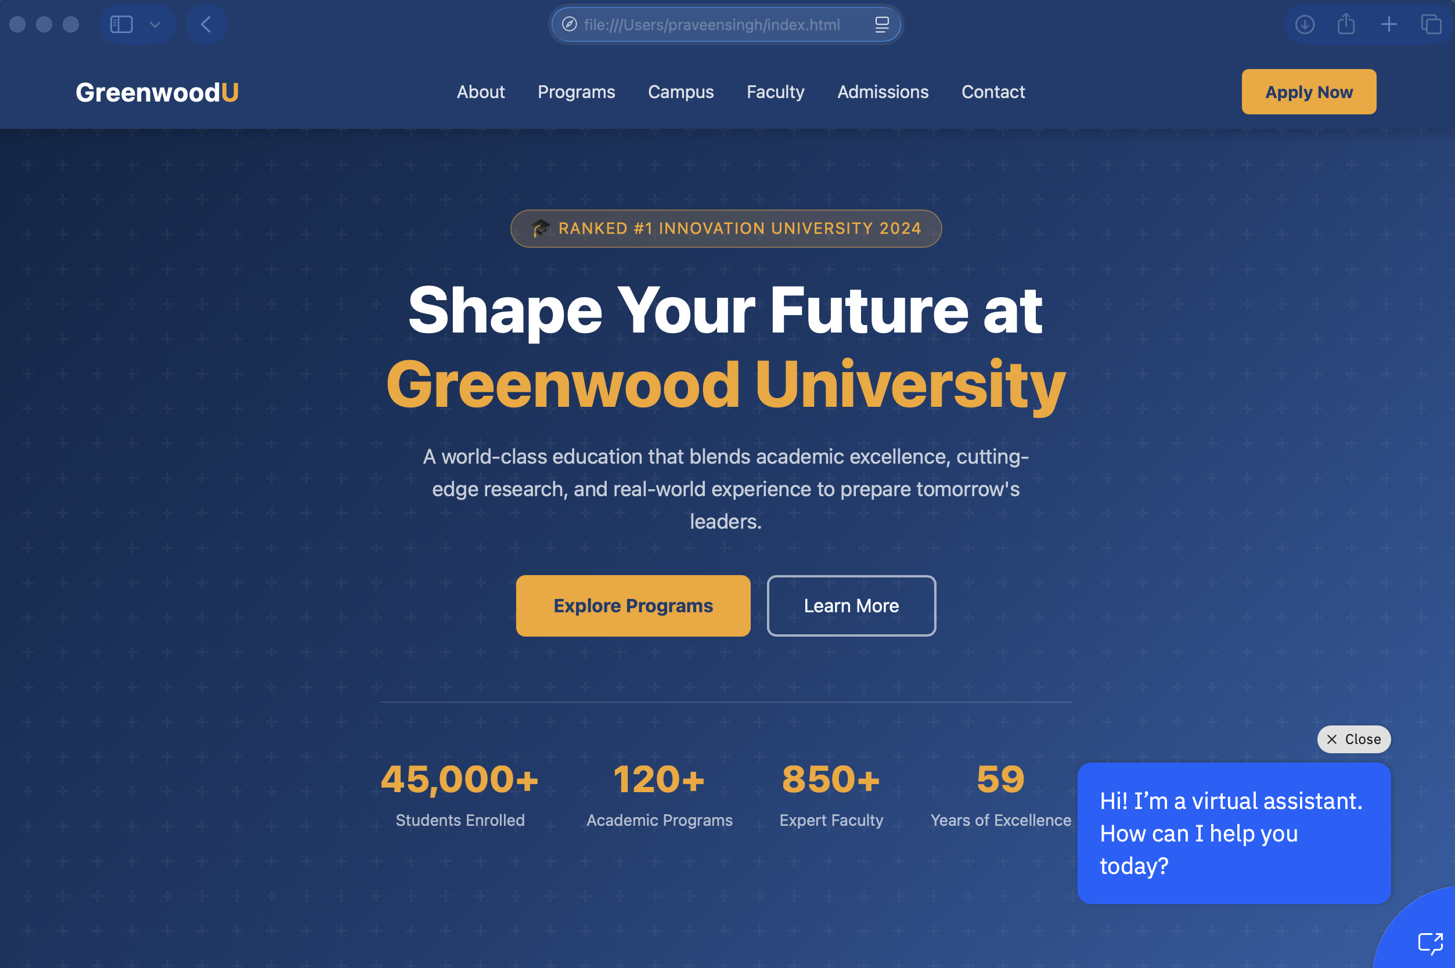
Project Output Screenshot
·
·
·

Slide 12
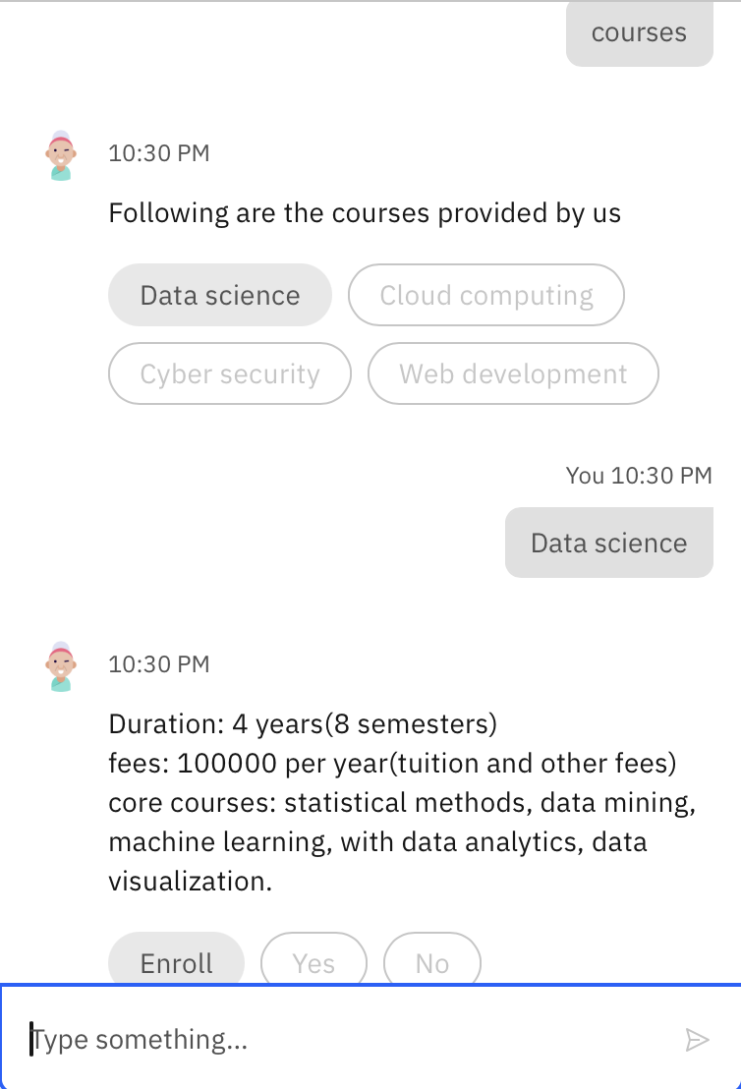
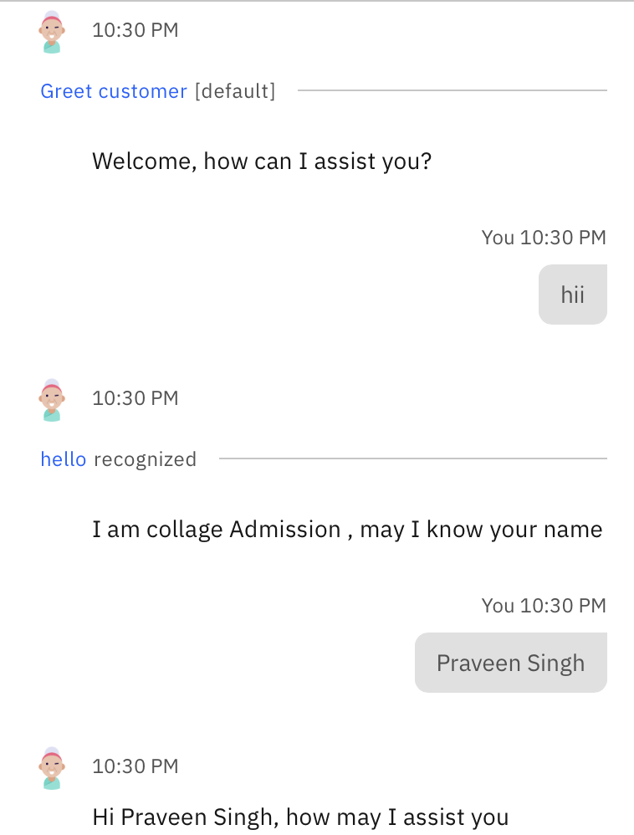
Project Output Screenshot
·
·
·

Slide 13
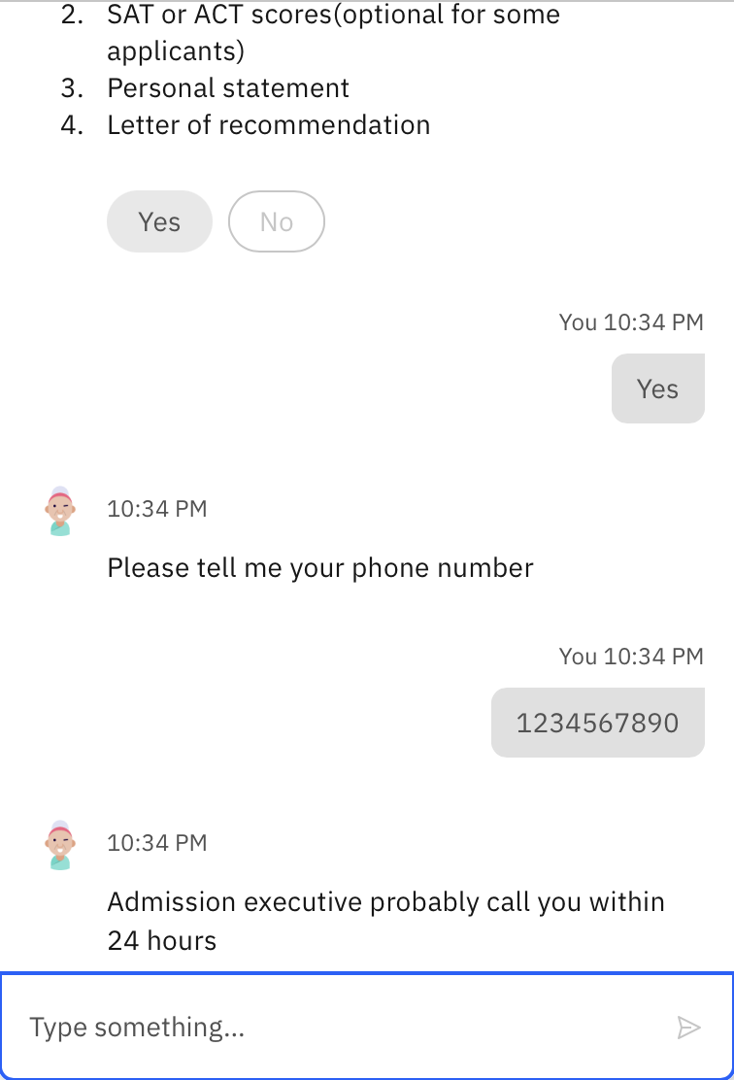
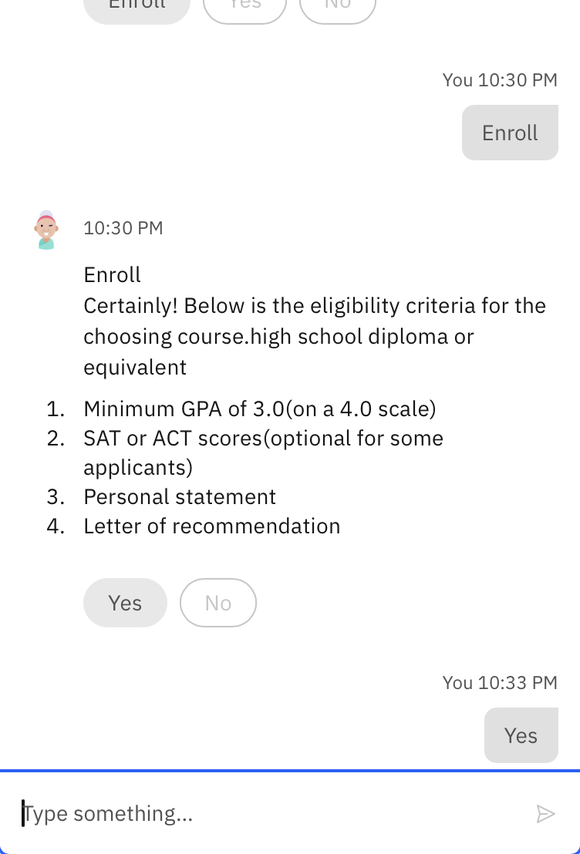
Project Output Screenshot
·
·
·

Slide 14
Novelty and Uniqueness
1. RAG-Based Responses
Responses are generated using retrieved college information rather than relying only on general model knowledge.
2. Admission-Focused AI
The chatbot is specifically designed for college admission-related requirements.
3. Conversational Interaction
Students can communicate naturally instead of searching through multiple webpages.
4. Personalized Guidance
The system can guide students based on their course interests and requirements.
5. Trusted Information
The knowledge base can prioritize official college documents and approved sources.
6. Custom Website Integration
The AI assistant can be directly integrated into the college website.
Unique Value
A single intelligent assistant that brings course discovery, eligibility, fees, applications, deadlines and FAQs into one conversational interface.

Slide 15
Git Hub Link
https://github.com/PraveenSingh7777/College-Admission-Agent.git
·
·
·

Slide 16
Future Scope
1. Application Status
Students can check their application status through secure institutional integration.
2. Multilingual Support
Support Hindi and other regional languages to improve accessibility.
3. Voice Assistant
Allow students to interact with the admission agent using voice.
4. Intelligent Course Recommendation
Recommend suitable courses based on student interests, qualifications and preferences.
5. Human Counselor Handoff
Transfer complex queries to an admission counselor.
6. Real-Time Admission Updates
Connect approved official sources to provide updated deadlines and notices.
7. Analytics Dashboard
Analyze frequently asked questions and identify gaps in admission information.
·
·
·

Slide 17
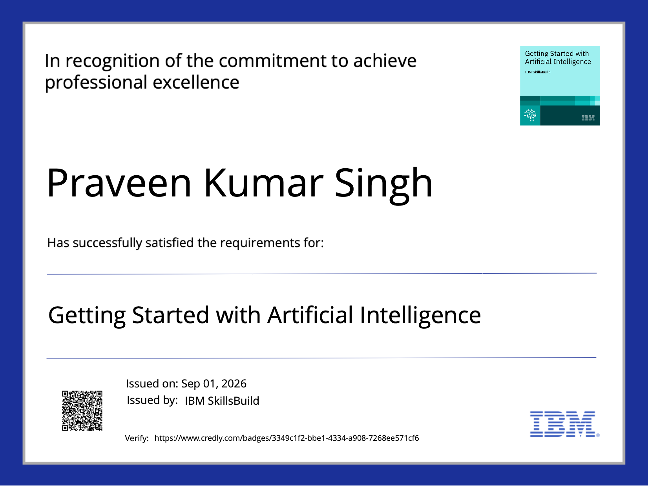
Certificates Earned:

Slide 18
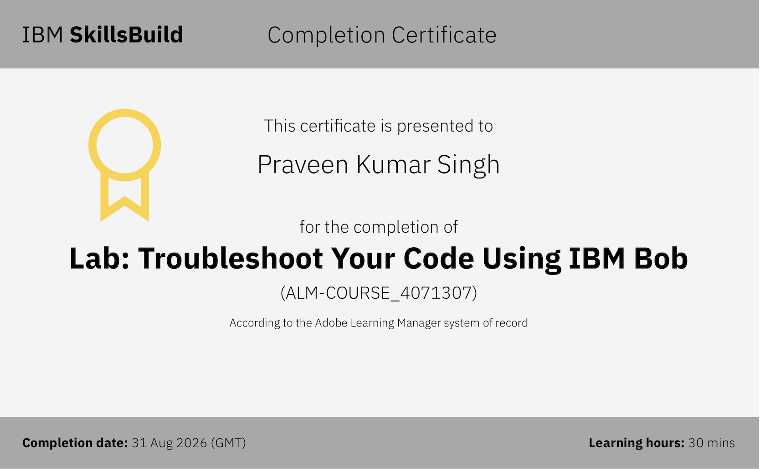
Certificates Earned:​

Slide 19


